Slide 1

An Analysis of Multi-Modal Surveys at LIDL Food Stores
WAYNE SAYERS, DORSET COUNTY COUNCIL
Notes:
In this presentation I am going to talk about some recent independently undertaken surveys at a selection of LIDL foodstores in England, that were input and validated to the TRICS standards.

Slide 2

Surveys at 6 LIDL Stores
Surveys undertaken in July 2016
One weekday plus one weekend day surveyed per site
Surveys independently commissioned
All data input and validated by TRICS
Notes:
These multi-modal surveys were undertaken in July 2016, and covered six separate LIDL stores, with each store having a weekday and a Saturday survey undertaken, giving us a total of 12 survey days. The surveys were independently undertaken by a consultant using selected data collection companies, and following the counts all of the data was supplied to TRICS for independent verification.

Slide 3
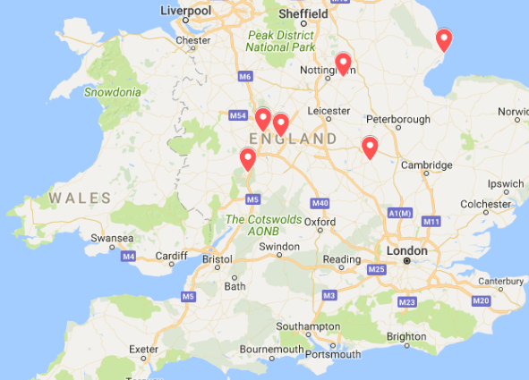
Store Locations
Bingham (Nottinghamshire)
Birmingham
Rushden (Northamptonshire)
Skegness
West Bromwich
Worcester
Notes:
The locations of the six stores can be seen on this map. As you can see, the locations are quite varied, with three of the sites in the West Midlands area and the other three at various other locations. The stores surveyed were in Bingham (Nottinghamshire), Birmingham, Rushden (Northamptonshire), Skegness, West Bromwich and Worcester. So a reasonable spread, with the sites being in a range of different location types as we will see when we go through them.

Slide 4
How Independent Surveys Work
Managed and undertaken independently of TRICS
Surveys use the standard TRICS data collection methodology
Supplied to TRICS for data input and validation
Certified as TRICS Compliant upon completion of successful validation process
Notes:
I thin it’s important at this stage to briefly explain how independent surveys work in TRICS. There are three types of surveys, those being within the regular TRICS data collection programme, surveys that TRICS managed on behalf of clients, and independent surveys. For the latter, TRICS has no input in the process until the validation stage. Independent surveys are undertaken using the TRICS data collection methodology, which is freely available to everyone. They are then supplied to TRICS, and for a fee (per survey), the data is put through TRICS input and validation testing. Once all validation queries raised have been answered, then the site(s) can be considered fully TRICS compliant, and a certificate is issued to this effect. In the case of this package of surveys, all six passed validation testing after a number of communications between TRICS and the data supplier, and TRICS compliance certificates were issued in each case.

Slide 5
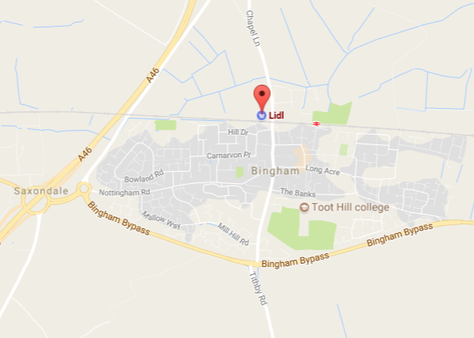
LIDL, Bingham (Nottinghamshire)
Small town to the east of Nottingham
Edge of town location
Population of approx. 9,000
Store has a travel plan in place
Notes:
So let’s have a look at the locations of each of the six stores and the key results that were obtained through the survey data. The first site is a store in Bingham, a small town located to the east of Nottingham. As you can see on the map, the site lies at the town’s northern edge, with the town having a population of around 9,000. One other thing to note about this store is it is the only one out of the six that had a travel plan in operation at the time the surveys were undertaken.

Slide 6
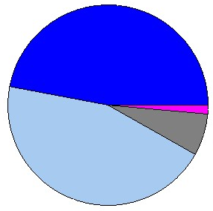
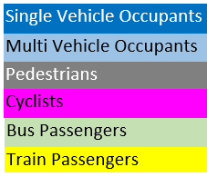
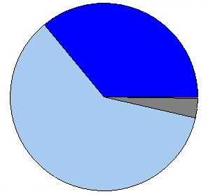
LIDL, Bingham: Key Results
Friday 15/07/16
Mode | In | Out | Total | %
Vehicle Occ. | 1487 | 1488 | 2975 | 91.8
Pedestrians | 112 | 108 | 220 | 6.8
Cyclists | 22 | 23 | 45 | 1.4
Public Trans. | 0 | 0 | 0 | 0
Total People | 1621 | 1619 | 3240
Saturday 16/07/16
Mode | In | Out | Total | %
Vehicle Occ. | 1857 | 1848 | 3705 | 96.5
Pedestrians | 66 | 61 | 127 | 3.3
Cyclists | 5 | 4 | 9 | 0.2
Public Trans. | 0 | 0 | 0 | 0
Total People | 1928 | 1913 | 3841
Notes:
Here are the key results at a glance for the Bingham store. On the left side of the screen are the two surveys and the inbound/outbound counts by mode type, also showing the modal split percentages, which are then displayed on the right hand side of the screen as pie charts. As you can see, 91.8% of all trips were by vehicle, with only small percentages covering pedestrian and cyclist activity. There were no trips by public transport to and from this store, which is probably not surprising given the store’s location in a small self-contained town.

Slide 7
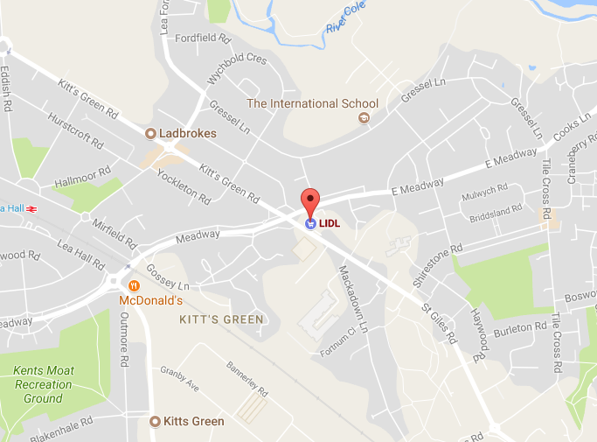
LIDL, Birmingham
Kitt’s Green area of Birmingham, an eastern suburb
Neighbourhood Centre location
Population within 500 metres radius 3,960
Notes:
We then move on to look at the store in Birmingham. This site is located in the Kitt’s Green area, an eastern suburb of the city. This store is situated in what TRICS calls a Neighbourhood Centre, a local area with various amenities and a local population, which in this case is 3,960 within a radius of 500 metres, to give you an example of the local population density. It is a significantly different scenario to the previous store.

Slide 8
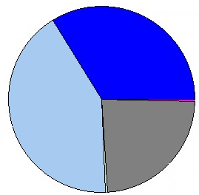
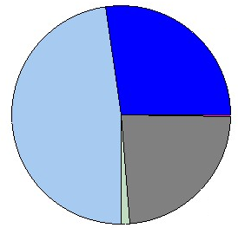
LIDL, Birmingham: Key Results
Tuesday 12/07/16
Mode | In | Out | Total | %
Vehicle Occ. | 1459 | 1465 | 2924 | 75.7
Pedestrians | 458 | 451 | 909 | 23.5
Cyclists | 8 | 8 | 16 | 0.4
Public Trans. | 8 | 8 | 16 | 0.4
Total People | 1933 | 1932 | 3865
Saturday 09/07/16
Mode | In | Out | Total | %
Vehicle Occ. | 2147 | 2143 | 4290 | 74.9
Pedestrians | 668 | 671 | 1339 | 23.4
Cyclists | 8 | 8 | 16 | 0.3
Public Trans. | 41 | 38 | 79 | 1.4
Total People | 2864 | 2860 | 5724
Notes:
When looking at the key results for this store, there is one thing that jumps out as being significantly different to the previous store, and that is the local walk-in activity as shown by the pedestrians percentage of 23 percent. This is clearly a local neighbourhood store which attracts a good number of local residents on foot, which we often find with this type of discount food store. There is also something else to look at. We can compare the public transport activity between the Tuesday and the Saturday counts, and see that on Saturdays there are significantly more public transport users visiting the store.

Slide 9
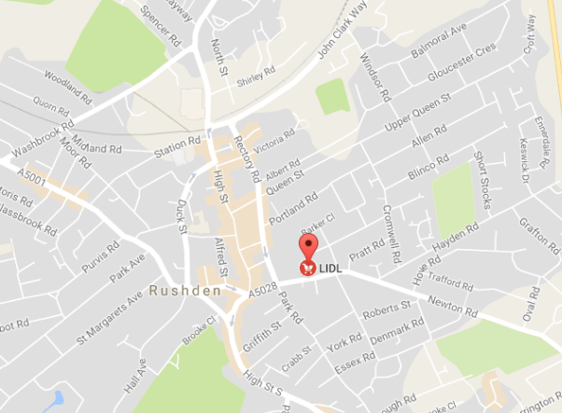
LIDL, Rushden
Town with a population of approx. 29,000
Edge of town centre location
Busy built-up town centre situated just to the west of the store
Notes:
Then we have the store at Rushden, a town in Northamptonshire with a population of approximately 29,000. This store is located in what we call an Edge of Town Centre location. The main built-up central core of the town is just to the west of the store. Again, a significantly different location scenario from the first two stores.

Slide 10
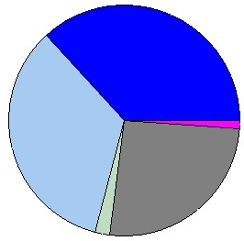
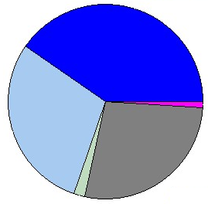
LIDL, Rushden: Key Results
Tuesday 19/07/16
Mode | In | Out | Total | %
Vehicle Occ. | 877 | 889 | 1766 | 70.8
Pedestrians | 334 | 311 | 645 | 25.9
Cyclists | 14 | 13 | 27 | 1.1
Public Trans. | 28 | 26 | 54 | 2.2
Total People | 1253 | 1239 | 2492
Saturday 16/07/16
Mode | In | Out | Total | %
Vehicle Occ. | 1149 | 1144 | 2293 | 69.8
Pedestrians | 463 | 439 | 902 | 27.4
Cyclists | 17 | 15 | 32 | 1.0
Public Trans. | 30 | 29 | 59 | 1.8
Total People | 1659 | 1627 | 3286
Notes:
Looking at the key results for the Rushden store, we can again see a good percentage of pedestrians (26-27%), which is not really surprising as the site is located close to the centre of town and also close to local residential areas. We note that there are some 400 more people arriving at the store on the Saturday than on the Tuesday, with this trend of stores being busier on Saturdays being evident for each of the sites we have looked at so far.

Slide 11
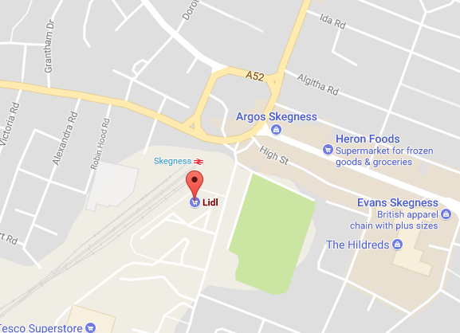
LIDL, Skegness
Town with a population of approx. 19,500
Seasonal variation affects store’s trip generation
Edge of town centre location in busy built-up area
A “Town Centre Exception” style survey required
Notes:
The next store is in Skegness, a town with a population of around 19,500. This is a seasonal coastal town, and surveys at different times of the year would no doubt bring varying results. It should be noted that all of the surveys took place just before the school Summer holidays were commencing, so the town would have been reaching is peak of activity at that time. The site is located at the southern edge of the town’s centre, in a busy built-up area. Because of the location of the store, in this case what we call a “Town Centre Exception” survey was necessary to correctly obtain the trip information. The TRICS Multi-Modal Methodology Document goes into detail about this type of survey, but in short a Town Centre Exception survey is designed to tackle the issues that may arise in interviewing people when they may be making a multi-trip at various locations in a town centre, with the site being surveyed being one of them. There are subtle differences in the survey specifications and the interview questions for such sites, designed to ensure that the main method of transport is correctly obtained through each interview.

Slide 12
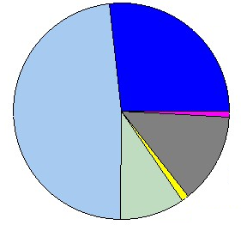
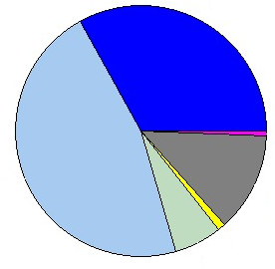
LIDL, Skegness: Key Results
Tuesday 19/07/16
Mode | In | Out | Total | %
Vehicle Occ. | 2479 | 2510 | 4989 | 74.9
Pedestrians | 449 | 450 | 899 | 13.5
Cyclists | 29 | 29 | 58 | 0.9
Public Trans. | 359 | 363 | 722 | 10.8
Total People | 3316 | 3352 | 6668
Saturday 16/07/16
Mode | In | Out | Total | %
Vehicle Occ. | 3264 | 3267 | 6531 | 79.4
Pedestrians | 523 | 527 | 1050 | 12.8
Cyclists | 27 | 27 | 54 | 0.7
Public Trans. | 294 | 294 | 588 | 7.1
Total People | 4108 | 4115 | 8223
Notes:
Here are the key results for Skegness, and they are interesting. The first thing to note is that public transport use is much higher for this site than the previous stores. This can be explained by a significant number of people travelling to and from the town centre by public transport. The Town Centre Exception survey style makes sure that these are picked up, with people not being recorded as pedestrians by mistake. There are also significant numbers of pedestrians and a reasonable number of cyclists, so this site can be considered quite multi-modal in nature. Its location of being just outside the core of the town may of course have a lot to do with this. The site is overall a busy one on both days, with predictably the Saturday being the busiest day again.

Slide 13
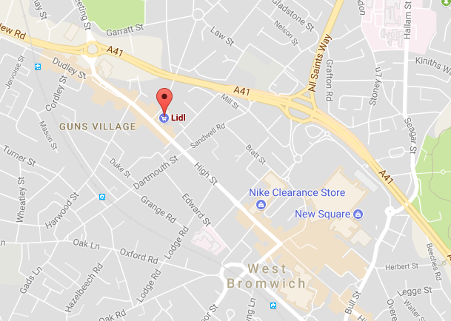
LIDL, West Bromwich
Area of the W. Midlands with population of approx. 75,000
On a high street in the Guns Village neighbourhood, north-west of West Bromwich centre
A “Town Centre Exception” style survey required
Notes:
Moving on to the next store now, at West Bromwich. This is located in the big West Midlands conurbation, with the local population being around 75,000. Again we have a slightly different situation in terms of the physical location of the store. In the case of this site, it is on a high street in the Guns Village neighbourhood centre, to the north-west of the centre of West Bromwich. It is quite unique out of the six stores that were surveyed. Also, like the previous survey, given the location of the store a “Town Centre Exception” survey was also required here to correctly obtain the main methods of transport for each recorded trip.

Slide 14
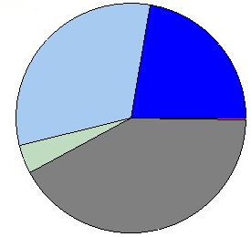
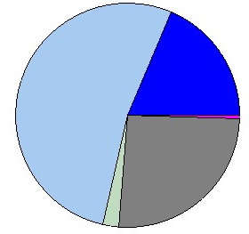
LIDL, West Bromwich: Key Results
Tuesday 12/07/16
Mode | In | Out | Total | %
Vehicle Occ. | 1117 | 1116 | 2233 | 53.8
Pedestrians | 865 | 875 | 1740 | 41.9
Cyclists | 4 | 4 | 8 | 0.2
Public Trans. | 85 | 84 | 169 | 4.1
Total People | 2071 | 2079 | 4150
Saturday 09/07/16
Mode | In | Out | Total | %
Vehicle Occ. | 2385 | 2373 | 4758 | 71.4
Pedestrians | 860 | 855 | 1715 | 25.8
Cyclists | 18 | 18 | 36 | 0.5
Public Trans. | 76 | 75 | 151 | 2.3
Total People | 3339 | 3321 | 6660
Notes:
Here are the key results for the West Bromwich store. There is one thing that stands out in these results. On the Tuesday, 42% of trips were pedestrians, with there being a significant 26% on Saturday too. An explanation for this high level of walk-in trips is two-fold. Firstly, there would have been a significant number of trips to the local neighbourhood area which may have taken in a number of different stores or other amenities. This would have boosted the pedestrian trips for the LIDL store if it was part of a larger trip. Secondly, the store is in an area of significant local population, so you would have also had your standard walk from home trips taking place. This is clearly another good site of multi-modal activity.

Slide 15
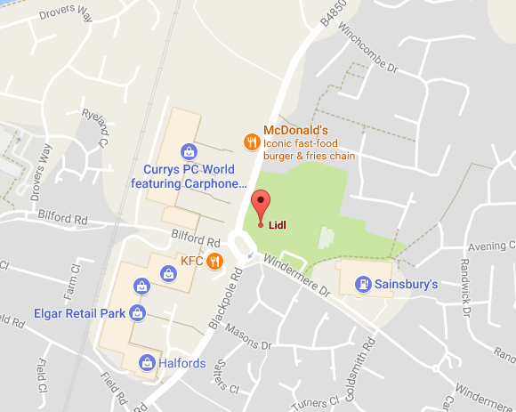
LIDL, Worcester
City with population of approx. 100,000
Edge of town location (northern edge)
Situated opposite a retail park, so care needed to include “cross over” trips correctly
Notes:
The final store is in Worcester, which is a city with a population of around 100,000. Once again, the location type is quite unique, in that this time the store is located opposite a retail park. It is at the northern edge of the city, and the fact that it is opposite a retail park meant that it was important to record any “cross-over” trips correctly. This kind of trip is also covered in the TRICS Multi-Modal Methodology Document. Essentially, if someone is visiting the retail park and also taking in a trip to LIDL as part of the same trip, then it is important that the main method for getting to/from the local area is obtained, to avoid an incorrect number of pedestrians being recorded. Again, a slight variation in the interview technique is required.

Slide 16
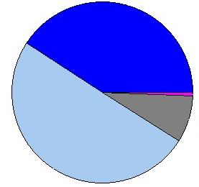
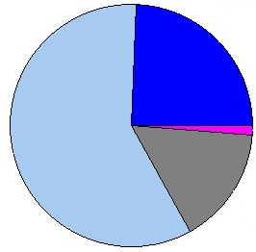
LIDL, Worcester: Key Results
Wednesday 13/07/16
Mode | In | Out | Total | %
Vehicle Occ. | 1708 | 1703 | 3411 | 91.0
Pedestrians | 155 | 156 | 311 | 8.3
Cyclists | 13 | 13 | 26 | 0.7
Public Trans. | 0 | 0 | 0 | 0.0
Total People | 1876 | 1872 | 3748
Saturday 16/07/16
Mode | In | Out | Total | %
Vehicle Occ. | 2307 | 2291 | 4598 | 83.1
Pedestrians | 430 | 438 | 868 | 15.7
Cyclists | 35 | 34 | 69 | 1.2
Public Trans. | 0 | 0 | 0 | 0.0
Total People | 2772 | 2763 | 5535
Notes:
Here are the key results for this final store. The store is dominated by vehicle occupants, as might be expected, but there are quite a few pedestrians visiting the site. Significantly, the number of pedestrians is much higher on the Saturday than it is on the Wednesday, but having said that, like all of the other stores, the overall level of trip activity is much higher on Saturday than on the weekday.

Slide 17
Closing Points to Note
The sites surveyed covered a variety of location types, which clearly have an effect on modal split.
As expected, Saturdays were busier than weekdays for each of the sites.
For groups of sites such as this, there may often be the need to adjust survey techniques in line with the TRICS Multi-Modal Methodology to ensure correctness in the results.
This was the first group of independently managed surveys dealt with by TRICS, and more are expected to arrive.
Notes:
There are no real “conclusions” that we end up with for this relatively small set of surveys, but we can make a few observations in summary. The sites that were surveyed covered a variety of location types, and it is clear from the varied results that location does have an effect on modal split, with the sites each displaying their own modal characteristics. As expected, Saturdays were busier than weekdays for each of the individual sites, something that of course is common in food retail (although we had never looked at this in discount food stores before). Also, for groups of sites such as this, there may often be the need to adjust survey techniques in line with guidance in the TRICS Multi-Modal Methodology Document, and those managing independent surveys such as this should be very aware of this, seeing as for such surveys the TRICS team do not manage the survey specifications. Finally, this was the first batch of independently managed surveys that we have received and dealt with, and each survey passed our stringent validation testing, which of course is a good thing for everyone. We expect more of these surveys to be supplied to us in the future, and we look forward to receiving them.

